Slide 1

PALACHOVY-TECHCLOUD
Semestral Project – Enterprise Informatics 2
Jesus Calleja Rodríguez, Taner Beyhan, Manuel Muñoz Marín, Jose Luis Pedraza Román

Slide 2
Introduction
Our company
Palachovy-Techcloud.
Goals: Server Rental Service
Customers: Different packages for differents types of customers
Basic-Cloud
Pro-Cloud
G-Cloud
Business Strategy: Offering different services according to the need of the customers. Seeking potential customers.
Finance statements: Initial capital investments. Donations. Agreements. Earnings with packages.
Difficulties: Be prepared to solve some problems. Conectivity, security. Maintenance of the system.

Slide 3
IT Governance Arrangement Matrix

Slide 4
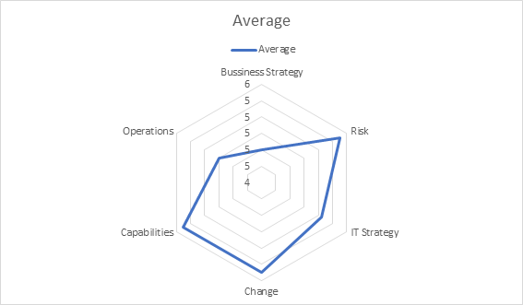
IT Governance questionnaire

Slide 5
Graphical results
In conclusion, although there is apparently a deficit in the value of the business strategy graph, this is compensated with good results in the field of changes in our chart.
The hight value of risk is due to our directors know perfectly the impacts of IT Governance on the work and personnel of the company, we obtain a correct management of
strategies and our intellectual capital.

Slide 6
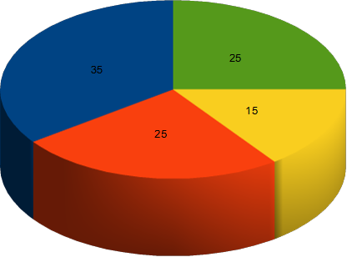

Investment portfolio

Slide 7
Graphical results
Informational: We are providing a informatical service so we need a hight percentage.
Strategic: We usually would like to increase the capacity of the system according to
the needs of our services.
Transitional: We have to stand our expenses ambitiously buying from external
companies.
Infrastructure: We need a huge infrastructure for our services.

Slide 8
Results chain

Slide 9
Process evaluation using maturity models
Level 0 – Initial: Focus on keep privacy of people safety. Hard work to ensure continous availabity of the system.
Level A – Repeatable: Provide the service continuosly also for the customers. Repeat the information because we are not able to find new customers.
Level B – Defined: Involving the implementation of the system somehow.
Level C – Managed: Infrastructure made by partners and investors sharing all the information.
Level D – Optimizing: Follow the trends of technology for being pioneers in the sector.

Slide 10
Service desk implementation
Provide contact constantly with our customers.
Having a channel for communication.
Allowing good integration of employeers.
Facilitating access to data.
Doing reports monthly.
Easy way of incorporating new suppliers and partners and allowing them to abandon it in
an easy way.

Slide 11
Establishing helpdesk

Slide 12
SLA preparation

